Slide 1
UE17CS490B – Capstone Project Phase – 2
Project Progress Review #1
Project Title : Style Consistent Kannada Font Generation
Project ID : PW21KS04
Project Guide : Prof. K S Srinivas
Project Team : Saahil B Jain - PES1201700241
Jeevana R Hegde - PES1201700633

Slide 2
Outline
Abstract and Scope of the Project.
Summary of work done in Capstone Project Phase – 1.
Extended Literature Survey.
Expected Deliverables of Capstone Project Phase – 2.
Gantt chart

Slide 3
Abstract and Scope
Problem statement:
The project is to automate the generation of new fonts for the Kannada scripts while taking inspiration from existing fonts from English language.

Slide 4
Abstract and Scope
Abstract:
Indian languages currently have a limited set of fonts available to choose from.
Creation or generation of new fonts is at present, a manual process.
This can tend to be a tedious, expensive and time-consuming process.
Our project goal initially was mainly to automate the generation of new fonts for the Kannada scripts while simultaneously ensuring generation of ಮಾತ್ರಗಳು (maatras) and ಒತ್ತಕ್ಷರಗಳು (otaksharas).
Our current objective leans towards taking inspiration from existing fonts from a language such an English which has an abundance of styles and inculcating these in creating new fonts for Kannada.
This is essentially Style-Transfer.

Slide 5
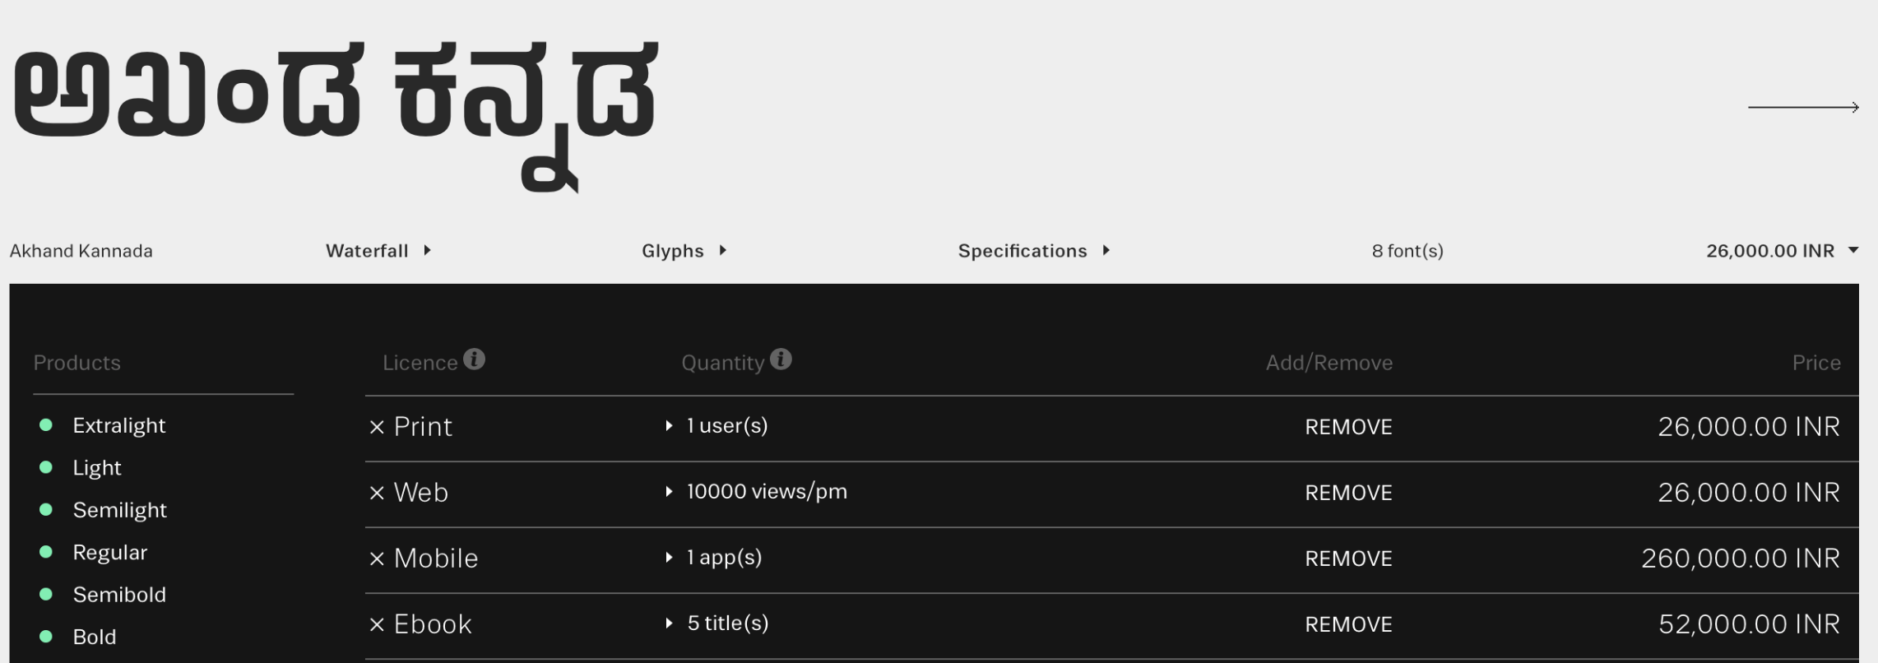


Abstract and Scope
Scope:
Indian Type Foundry (ITF) is a company which manually creates customized fonts for various languages.
The charges range from 26,000INR - 2,60,000INR for a specific typeface.

Slide 6
Abstract and Scope
Scope:
Currently font generation is done where the designers must manually draw and further trace Glyphs (characters) using software tools such as Font Developer.
For each font, the time varies from a couple of hours to a couple of days.
Our project aims to automate this process while simultaneously trying to incorporate style inspired from fonts available for other languages(Style transfer).
Hence makes the process less time-consuming, more efficient(using style consistency) and provides a varied set of options to choose from at a cheaper price.

Slide 7
Summary of Work Done in Capstone Project Phase - 1
Summary of Phase - 1:
Successfully built and trained a Neural Cellular Automata and updated it’s filters to generate style-consistent fonts for Kannada script.
1. Fonts generated are style-consistent.
2. Generates new fonts without requirements of multiple fonts(data).

Slide 8

Summary of Work Done in Capstone Project Phase - 1
Demonstration:

Slide 9
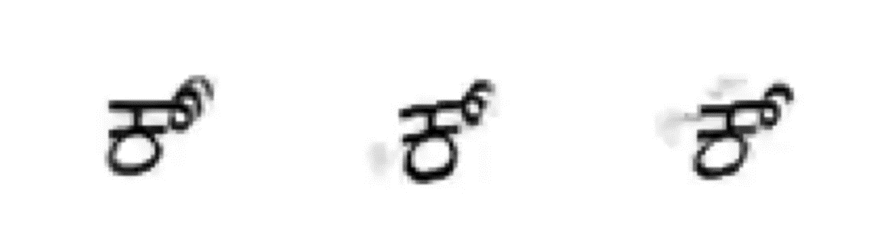
Summary of Work Done in Capstone Project Phase - 1
Demonstration:

Slide 10
Summary of Work Done in Capstone Project Phase - 1
Suggestions and remarks:
To expand the font generation styles to more/other languages apart from Kannada.

Slide 11
Extended Literature Survey
Research Paper
[1] Samaneh Azadi, Matthew Fisher, Vladimir Kim, Zhaowen Wang, Eli Shechtman, Trevor Darrell, “Multi-Content GAN for Few-Shot Font Style Transfer”, Dec. 01, 2017. [Online]
Available: https://arxiv.org/pdf/2006.06676.pdf [Accessed Jan. 16,2021]
Summary:
Aims to build a model to apply style transfer for fonts. The model is trained on multiple fonts of a few letters English language, then the style of these few alphabets is then applied to all the other letters of English.
This paper provides a significant benchmark to our project.

Slide 12



Extended Literature Survey
Pros:
Achieves good level of style transfer for letters similar to training letters.
Cons:
Style transfer is good only for letters similar to the training data.
Works only for letters on same language.
Model can't be applied to languages like Kannada as the letters itself vary a lot.

Slide 13








Extended Literature Survey
Cons:

Slide 14
Extended Literature Survey
Research Paper
[2] Yonggyu Park, Junhyun Lee, Yookyung Koh, Inyeop Lee, Jinhyuk Lee, Jaewoo Kang, “Typeface Completion with Generative Adversarial Networks”, Dec. 13, 2018. [Online],
Available: https://arxiv.org/pdf/1811.03762.pdf [Accessed Jan. 05, 2020]
Summary:
Aims to build a model that takes one-character images as an input and generates all the remaining characters in the same font of input characters.

Slide 15
Extended Literature Survey
Pros:
Can generate same fonts for all letters of the language with just one input letter.
Cons:
Hight data dependency.
Style learning from input letter cannot be extrapolated to letters outside the training set.

Slide 16
Extended Literature Survey
Research Paper
[3] Yizhi Wang, Peking University, “Attribute2Font”, May. 16, 2020. [Online],
Available: https://arxiv.org/pdf/2005.07865v1.pdf [Accessed Jan. 15, 2021]
Summary:
The paper aims to build a model which is capable of generating glyph images according to user-specified font attributes. The attributes are -
Angular, Bad, Disorderly, Happy, Italic, Serif, Thin and Wide.

Slide 17
Extended Literature Survey
Pros:
Can generate style consistent fonts for an incredibly large combination of attribute values.
Can focus more on specific attributes and less on other attributes.
Solution would work for any language If the abundant data is available.
Cons:
Large amounts of labelled data needed.
Can't work for Indian languages like Kannada as fonts itself are limited.

Slide 18
Expected Deliverables in Phase - 2
Expected deliverables:
Data collection – collect the Glyphs of different alphabets of different fonts for English.
Train a model to perform Style transfer.
For each letter of the Kannada alphabet along with maatras, perform style transfer.
Obtain new fonts from various existing fonts on English.

Slide 19
Timeline and Plan
Timeline for execution:
WEEK 1 | WEEK 2 | WEEK 3 | WEEK 4
Literature survey on problem statement. | Literature survey and definite problem formulation. | Literature survey on proposed architecture. | Obtaining and cleaning dataset.
WEEK 5 | WEEK 6 | WEEK 7 | WEEK 8
Build basic model for Style Transfer. | Train basic model for Style Transfer. | Train basic model for Style Transfer. | Perform style Transfer for each alphabet of Kannada Script.
WEEK 9 | WEEK 10 | WEEK 11
Incorporating maatras for every letter. | Fine tuning and documentation. | Fine tuning and documentation.

Slide 20
Thank You

